Slide 1
Pratik Prakash Bhujade
Student Number - 3010568
MSc in Big Data Management & Analytics

Slide 2
Loan Underwriting Prediction
Reinforcement learning to predict loan underwriting

Slide 3
Introduction and overview
Loan industry involves in lending of money by one or more individuals or organizations to other individuals or organizations. The risk is high in this industry as it involves money.
The aim is to apply machine learning techniques for prediction of such non-credible borrowers.
It will help the financial sectors to be more vigilant and bear fewer losses
It will also help in saving time taken in the whole process of background manual checking

Slide 4
Business Domain Problems
A non-credible borrower results loss to the lender
The manual background checking process is time consuming
To identify the possibilities of using reinforcement learning technique to minimize the risk involved in loan underwriting by identifying, classifying and predicting credible customer son the basis of feature variables as the inputs of the borrower

Slide 5
Proposed Solution
Use past data of the insurance companies regarding the loan understatement and use the features in that data to identify if the borrower is credible or not
We use Q-learning and python to screen out the borrowers which are probable future defaulters.

Slide 6
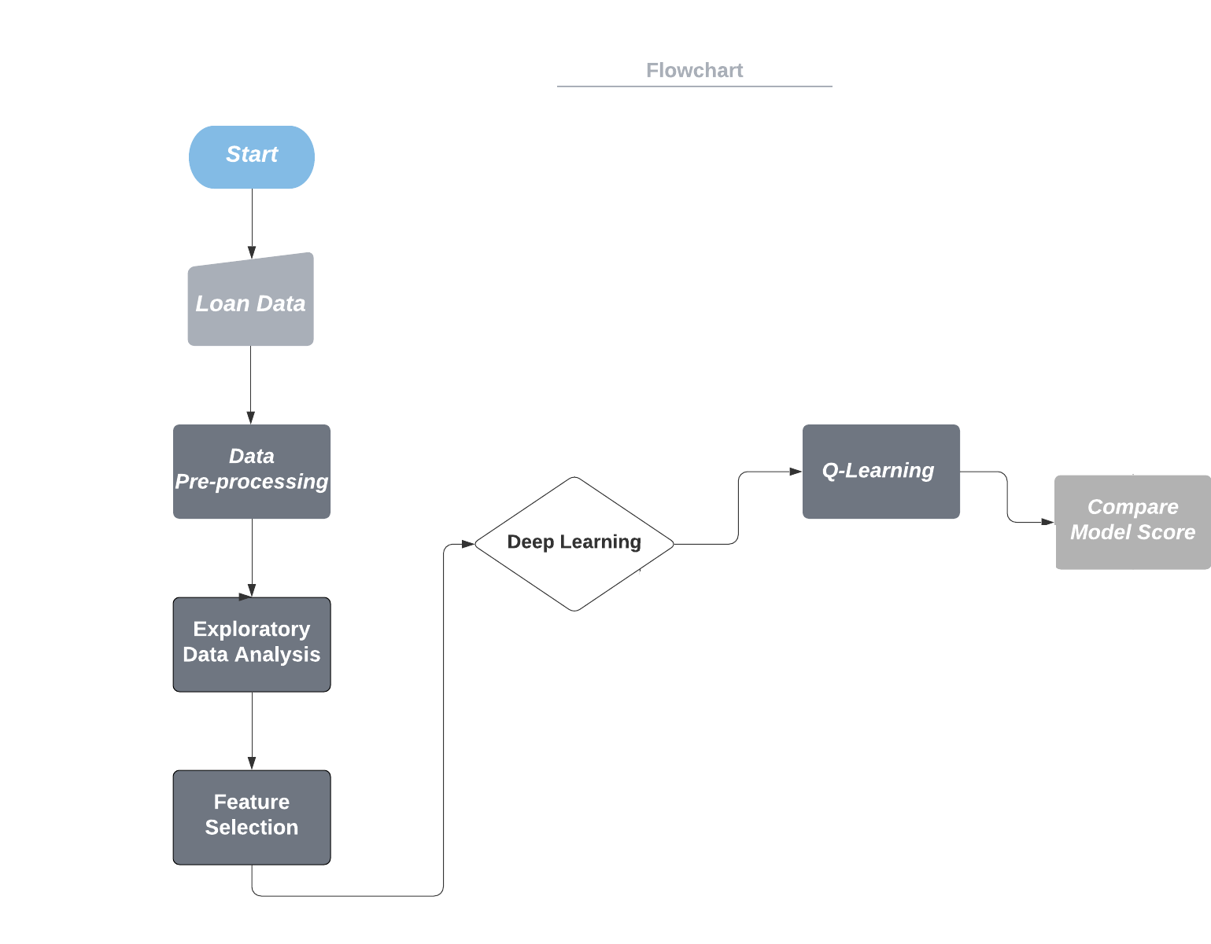
Methodology

Slide 7
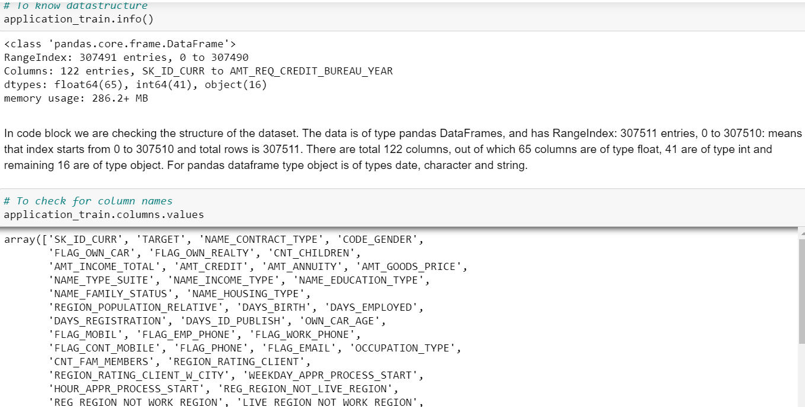
Exploratory data analysis

Slide 8
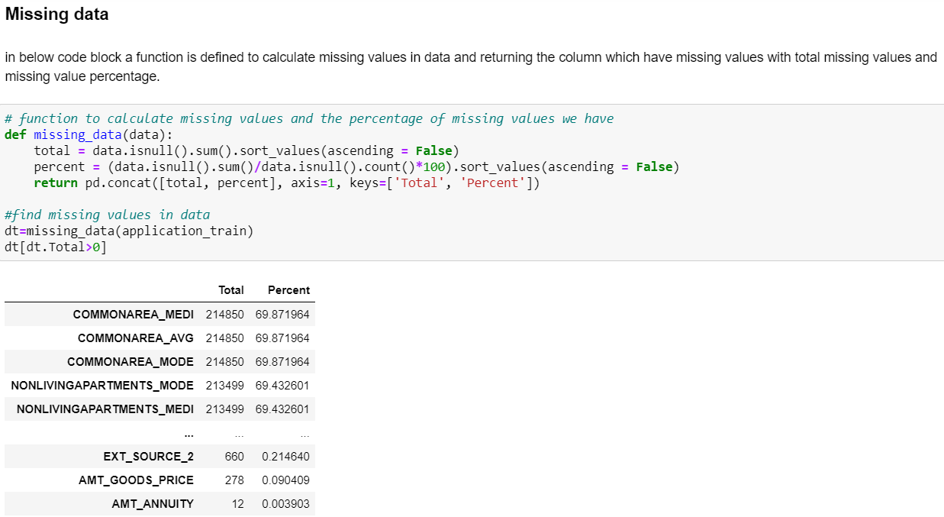
Exploratory data analysis

Slide 9
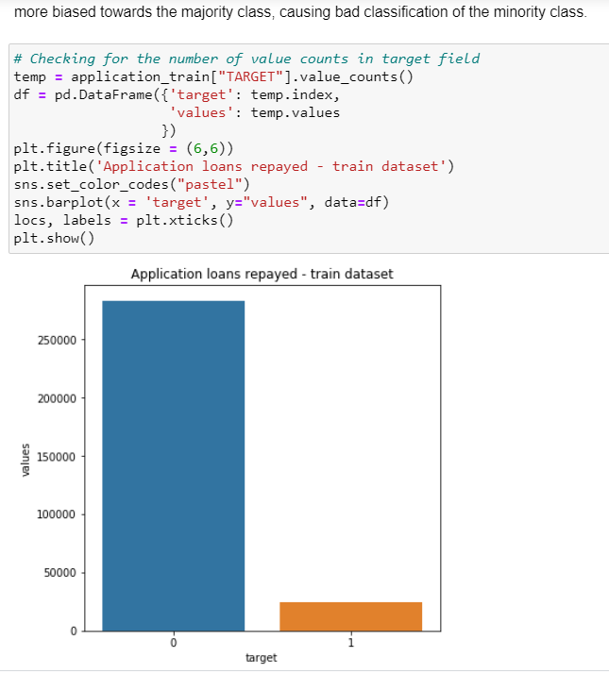
Exploratory data analysis: Class Balancing

Slide 10
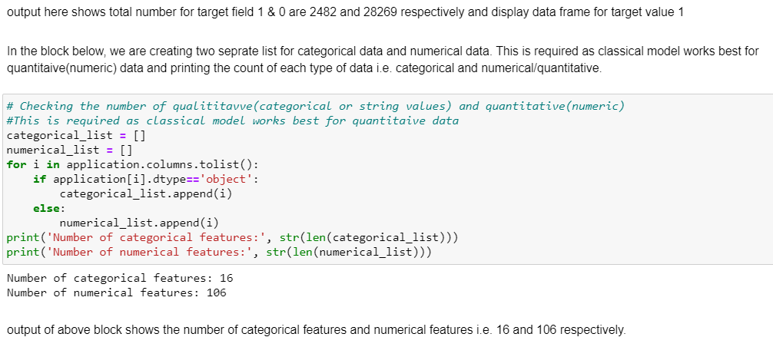
Exploratory data analysis : Checking for strings in data

Slide 11
Data pre-processing
Fill in missing values
Identify outliers and smooth out noisy data
Correct inconsistent data
Normalization: scaled to fall within a small, specified range
Feature selection (i.e., attribute subset selection- Chi-Square and cross validate
Class Balancing

Slide 12
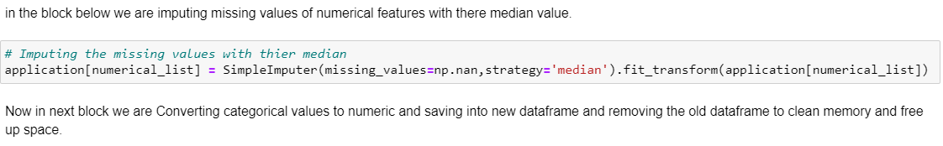
Data pre-processing: Missing Data Treatment

Slide 13
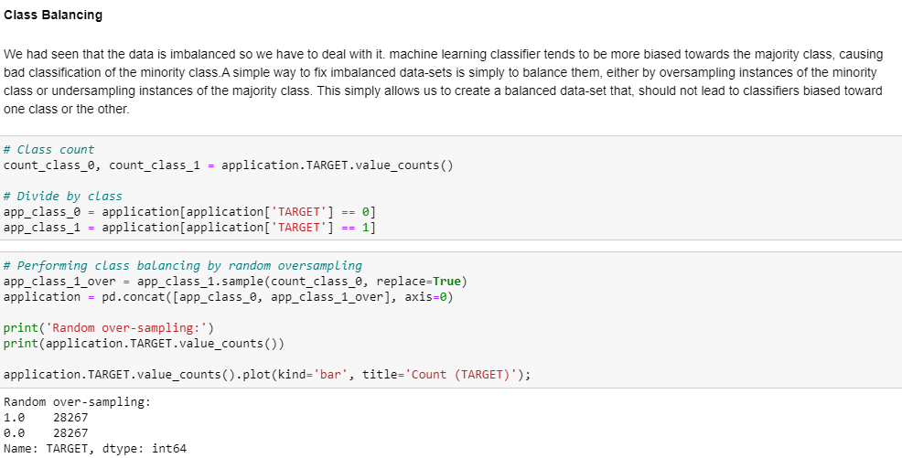
Data pre-processing

Slide 14
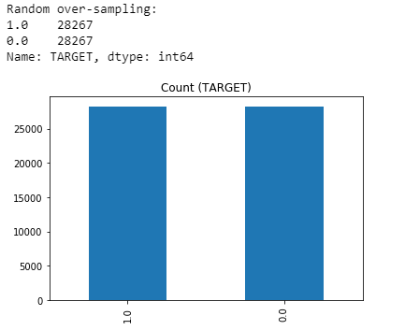
Data pre-processing

Slide 15
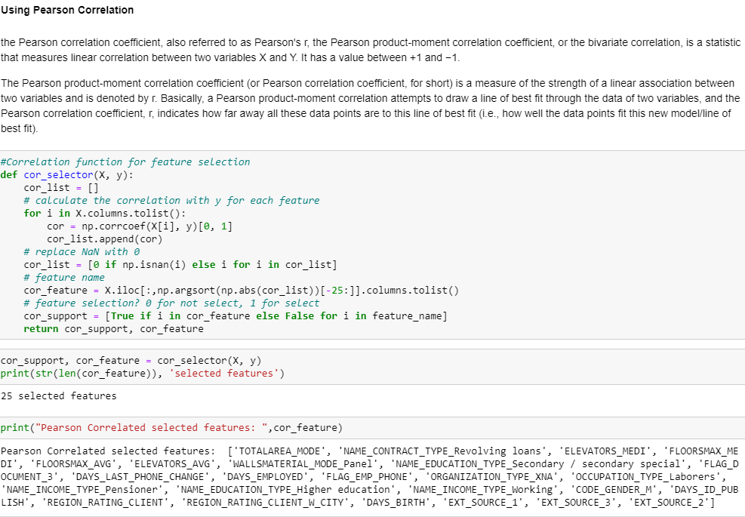
Data pre-processing: Feature Selection

Slide 16
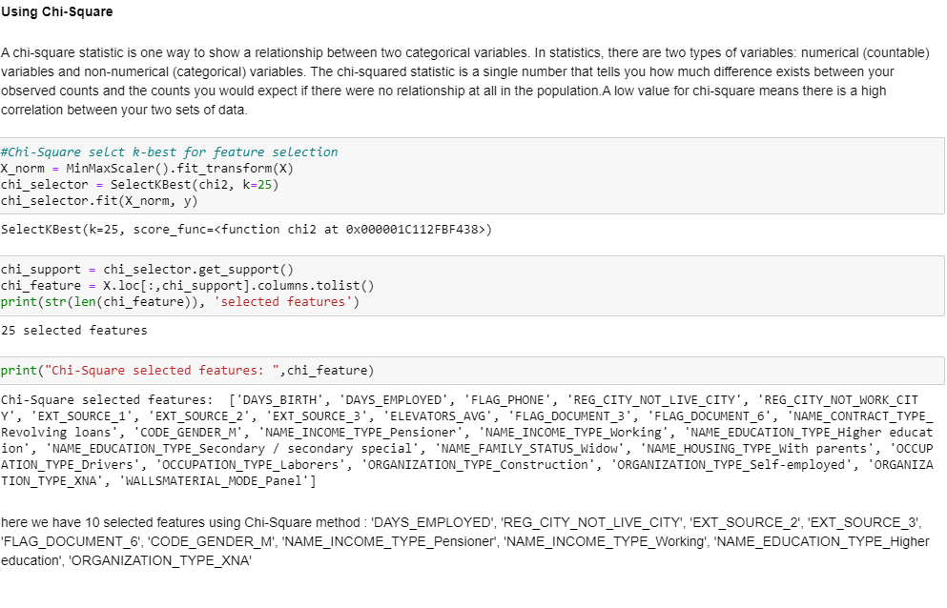
Data pre-processing: Feature Selection

Slide 17
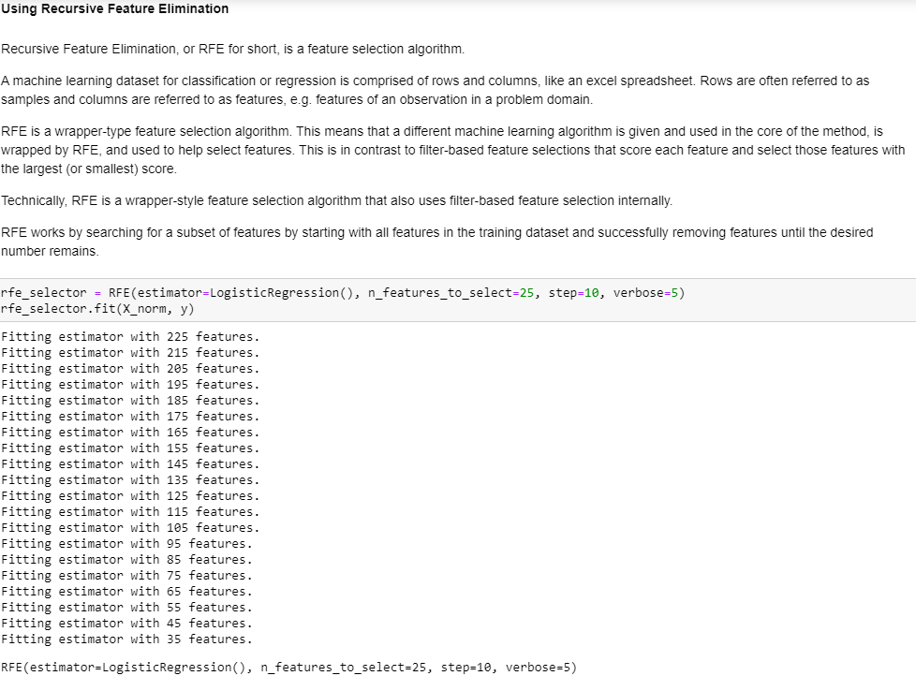
Data pre-processing: Feature Selection

Slide 18
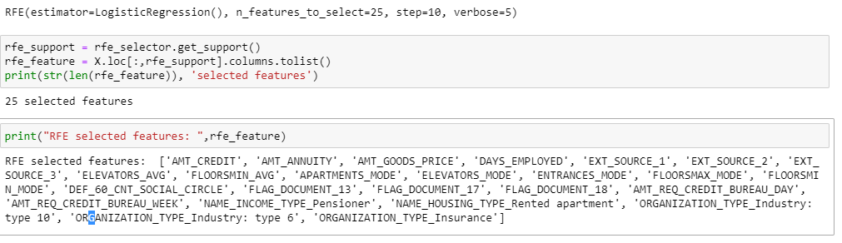
Data pre-processing: Feature Selection

Slide 19
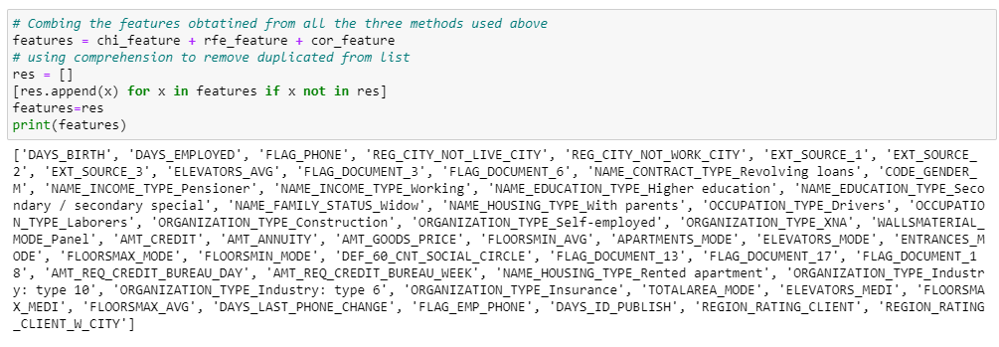
Data pre-processing: Feature Selection

Slide 20
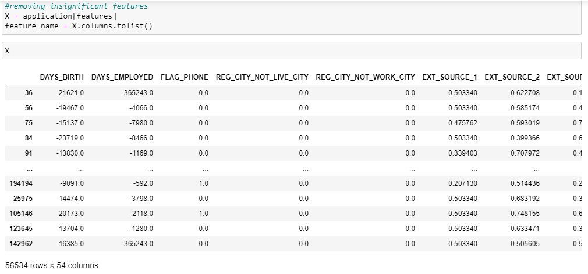
Data pre-processing: Feature Selection

Slide 21
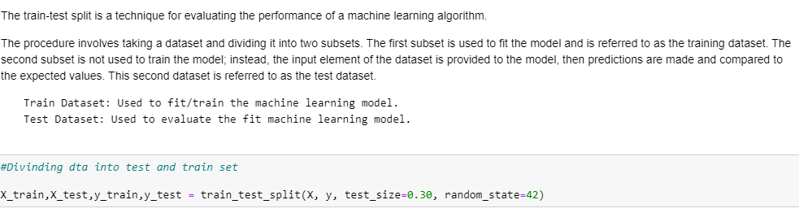
Data pre-processing: Train Test Split

Slide 22
Q-Learning
Q-learning is a model-free reinforcement learning algorithm to learn a policy telling an agent what action to take under what circumstances
It does not require a model of the environment, and it can handle problems with stochastic transitions and rewards, without requiring adaptations

Slide 23
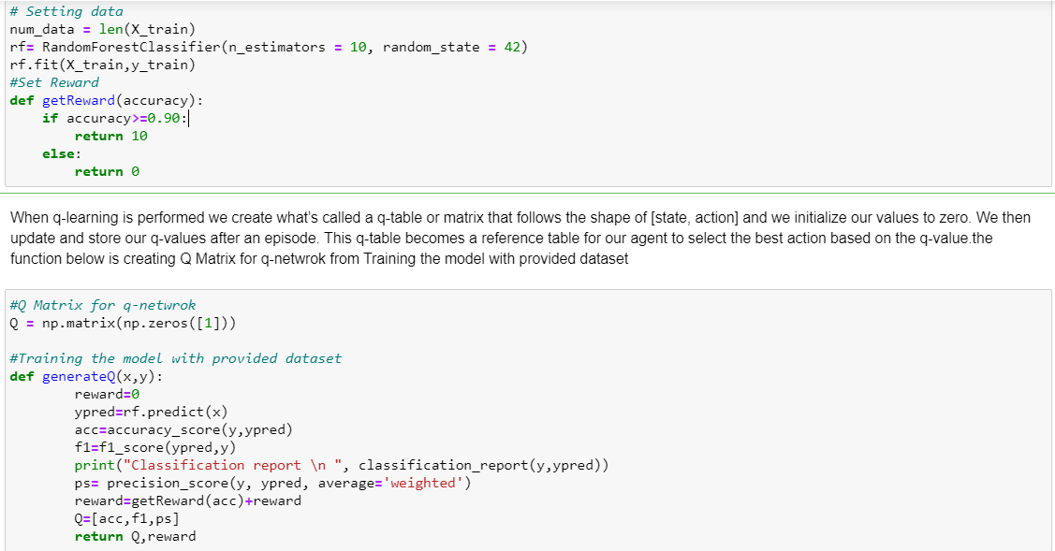
Q-Learning

Slide 24
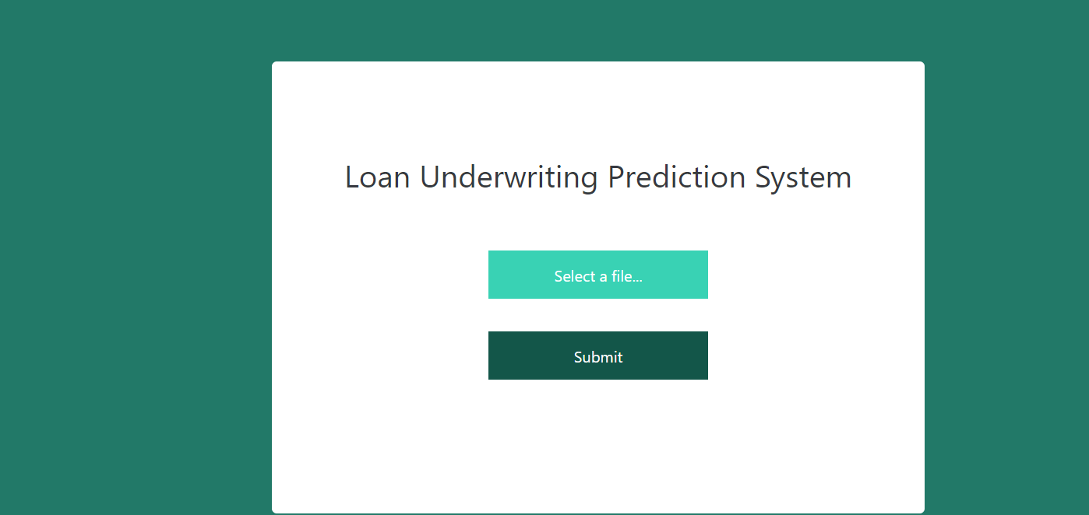
Q-Learning: User Interface

Slide 25
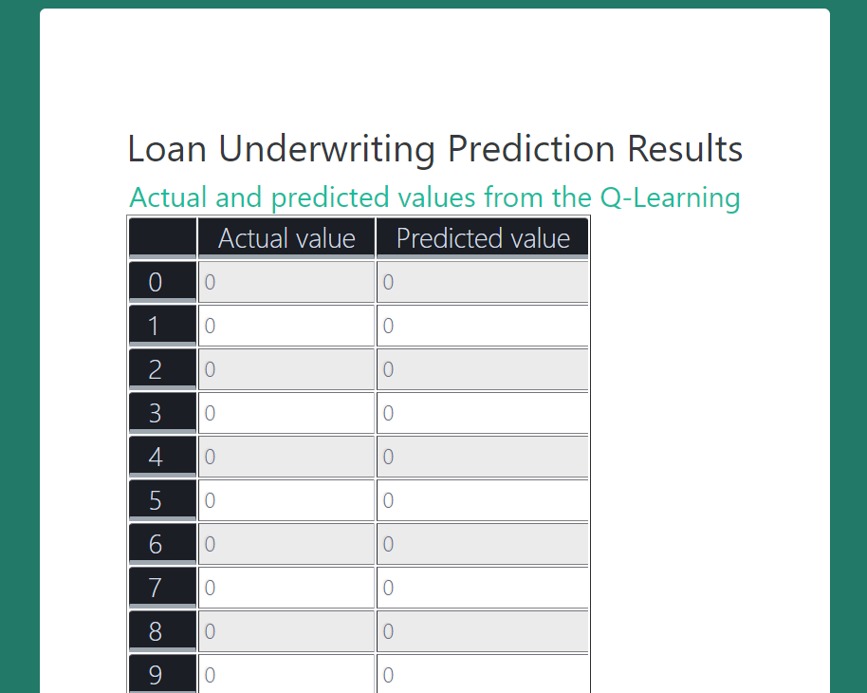
Q-Learning : User Interface

Slide 26
Evaluation
Accuracy : Accuracy is the most intuitive performance measure and it is simply a ratio of correctly predicted observation to the total observations.
F1-Score: F1 Score is the weighted average of Precision and Recall.
Precision: Precision is the ratio of correctly predicted positive observations to the total predicted positive observations.
Recall: Recall is the ratio of correctly predicted positive observations to the all observations in actual class - yes.

Slide 27
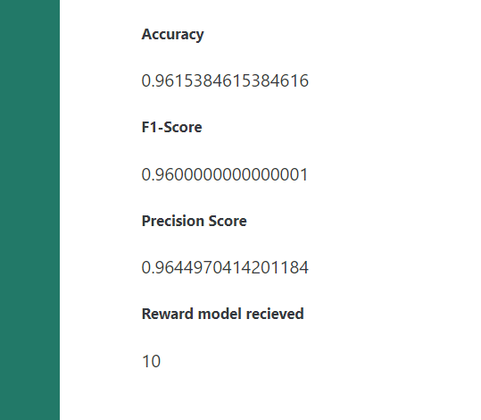
Evaluation

Slide 28
Conclusion
The user interface test, shows that the model accuracy score is 95.57%, F1-Score is 94.74% and the precision score is 95.01%.
The model receiving the reward of 10 as it achieved the accuracy score of more than 90%.
There is negligible gap in accuracy and F1-score this means that the model is working fine and there are no problems of overfitting or Underfitting or class imbalance in the data.

Slide 29
Future Work
We recommend using deep q-learning where we can add the benefit of neural network in the process of off-policy model implementation.
The use of H2O streaming library implementing spark framework can also be investigated.
The use of big data can also lead to better performing models. As the model is as good the data is.

